Slide 1

Usability Testing And Verification
The citizen Journalist
By Anirudh
11013401

Slide 2
Introduction
The Citizen Journalist
A newspaper that the crowd Sources the news from information provided by the citizens. The idea is the citizens will come up with events, not just news events but also theater events book reviews or sporting events etc. They will not just take photos of the events but also write a story that goes with the events. Then, They will file for a consideration to the publication of the newspaper

Slide 3
Introduction to use case
Users should find it easy to read at night with low brightness
User should get daily news updates to be more aware
They can login into website to get more usage.
Citizens can upload news to create more awareness among people.
Users can update any Events around them.

Slide 4
Motivation

Slide 5
Competitors
NO. | Newspaper | Website link
1. | Süddeutsche Zeitung | https://www.sueddeutsche.de/
2. | Frankfurter Allgemeine Zeitung | https://www.faz.net/aktuell/
3. | Die Welt | https://www.welt.de/
4. | Handelsblatt | https://www.handelsblatt.com/sea/?gclid=Cj0KCQjw3qzzBRDnARIsAECmryrET5X91XSHXPC3qxngO7Qp5XxAz6ADAwibboryWVSRyZG5lGrIcd8aAl64EALw_wcB

Slide 6
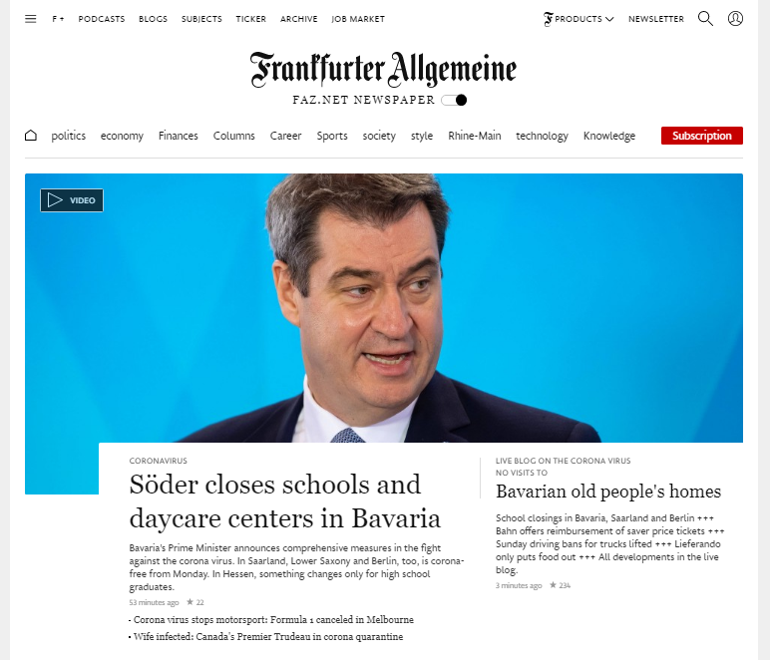
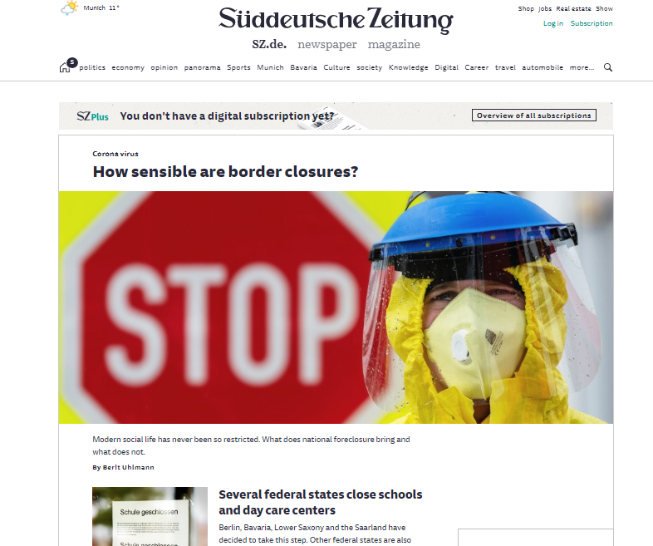
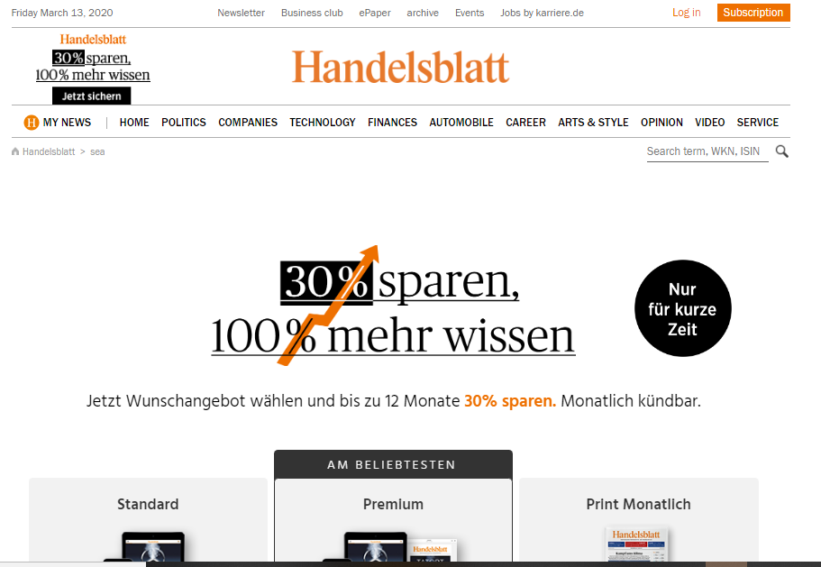
Competitors

Slide 7
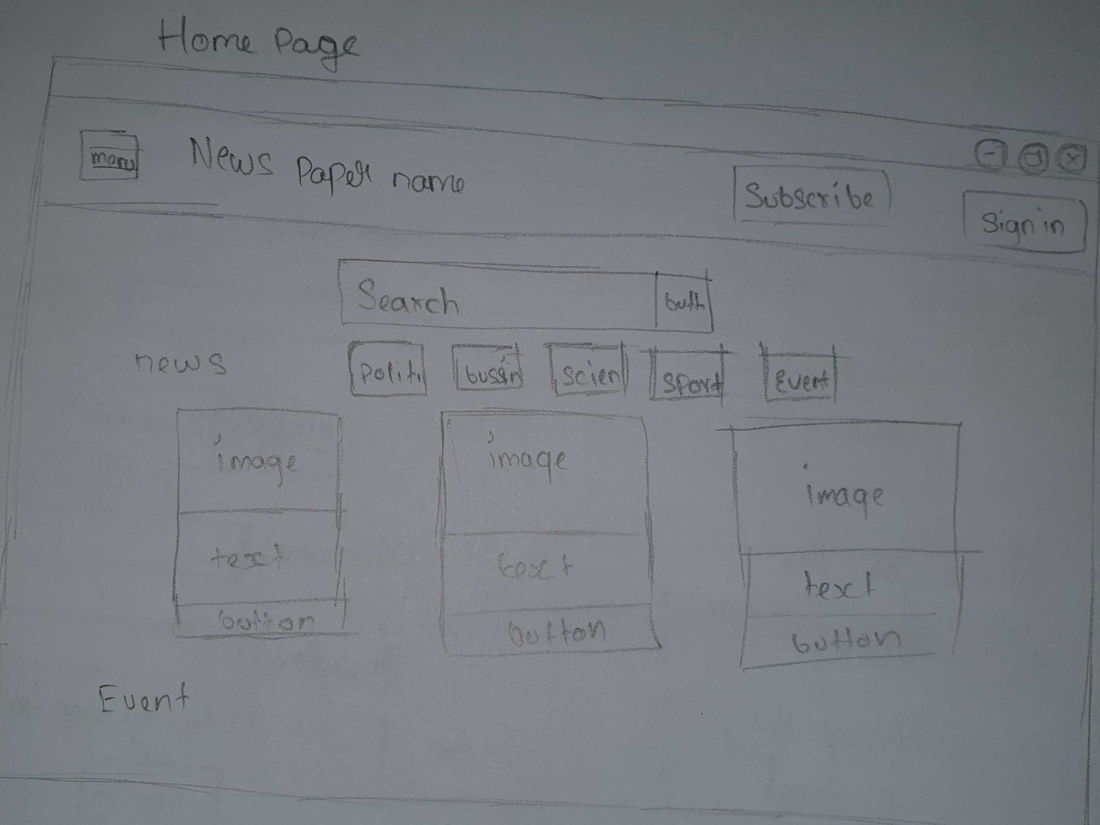
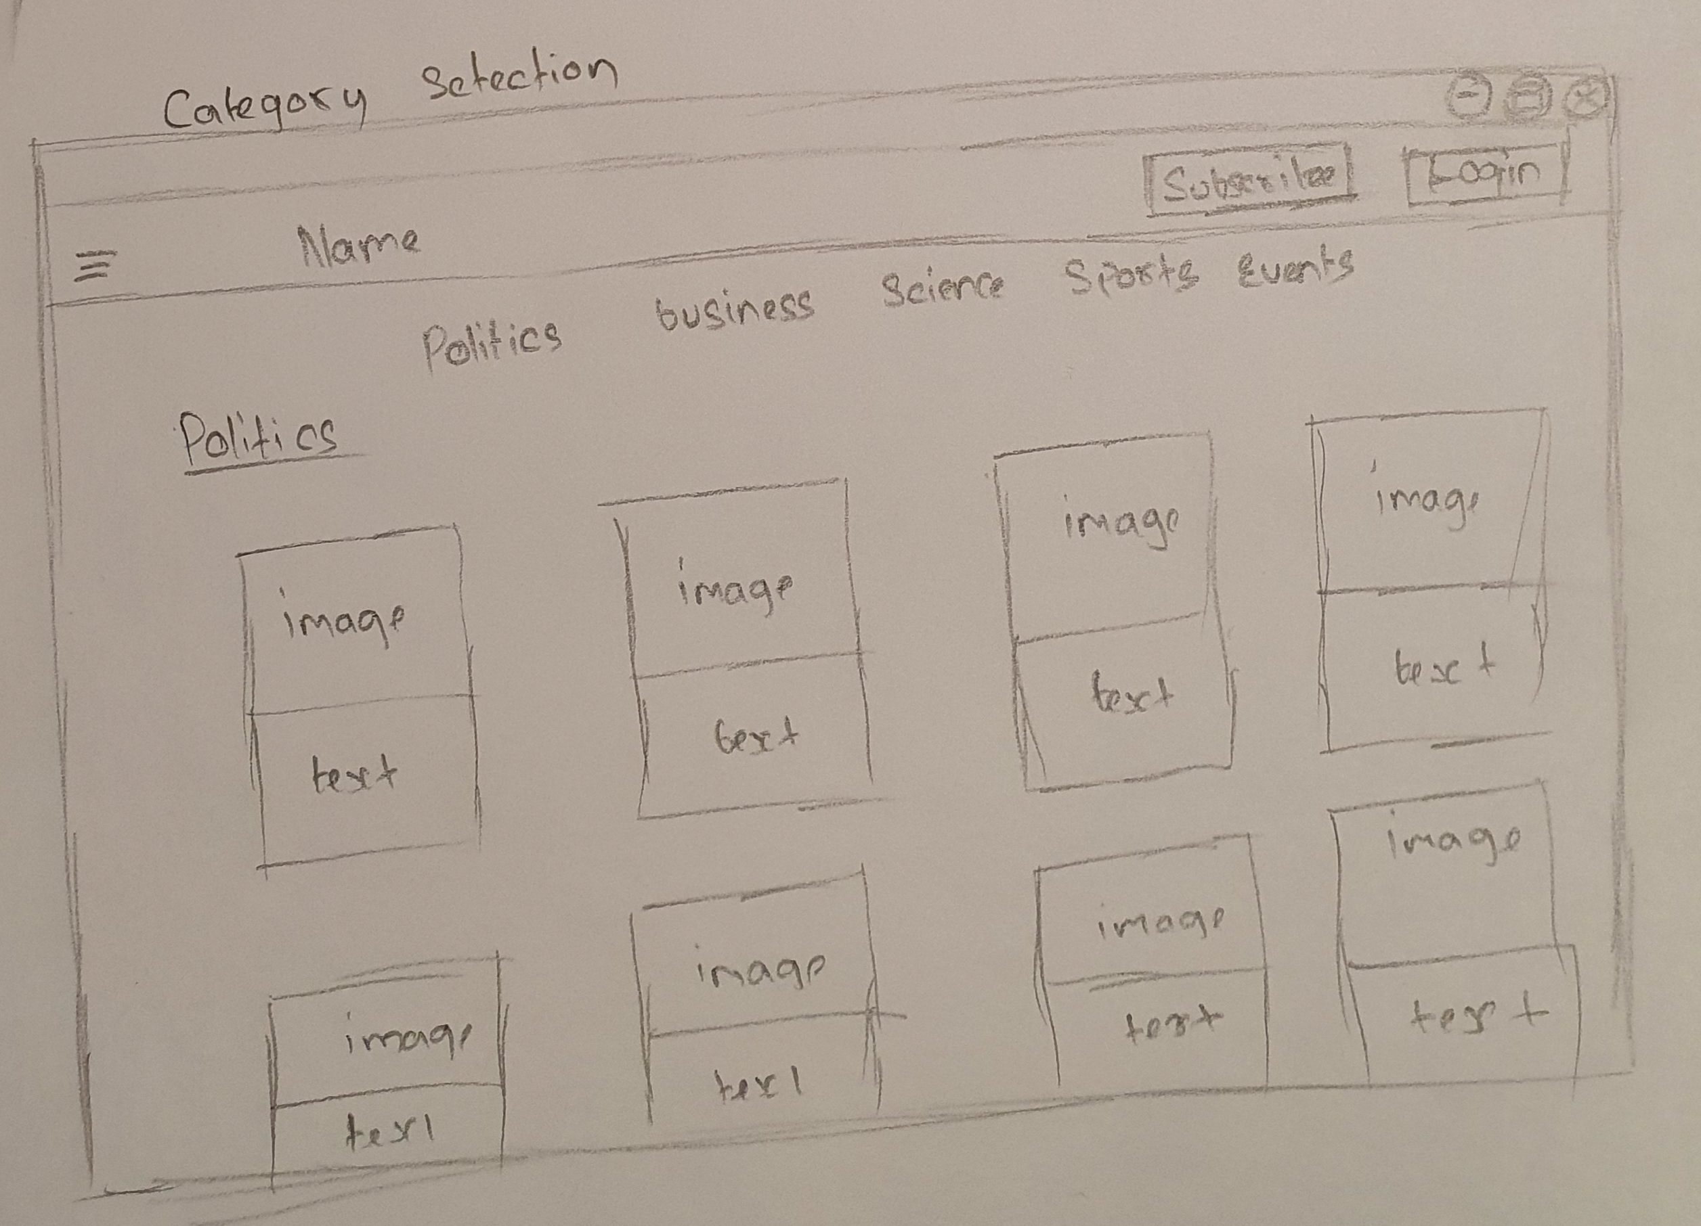
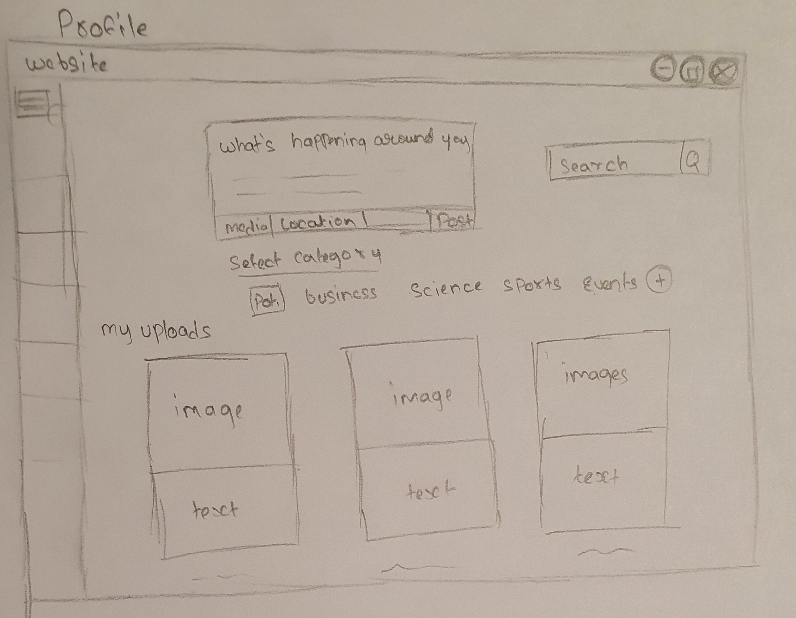
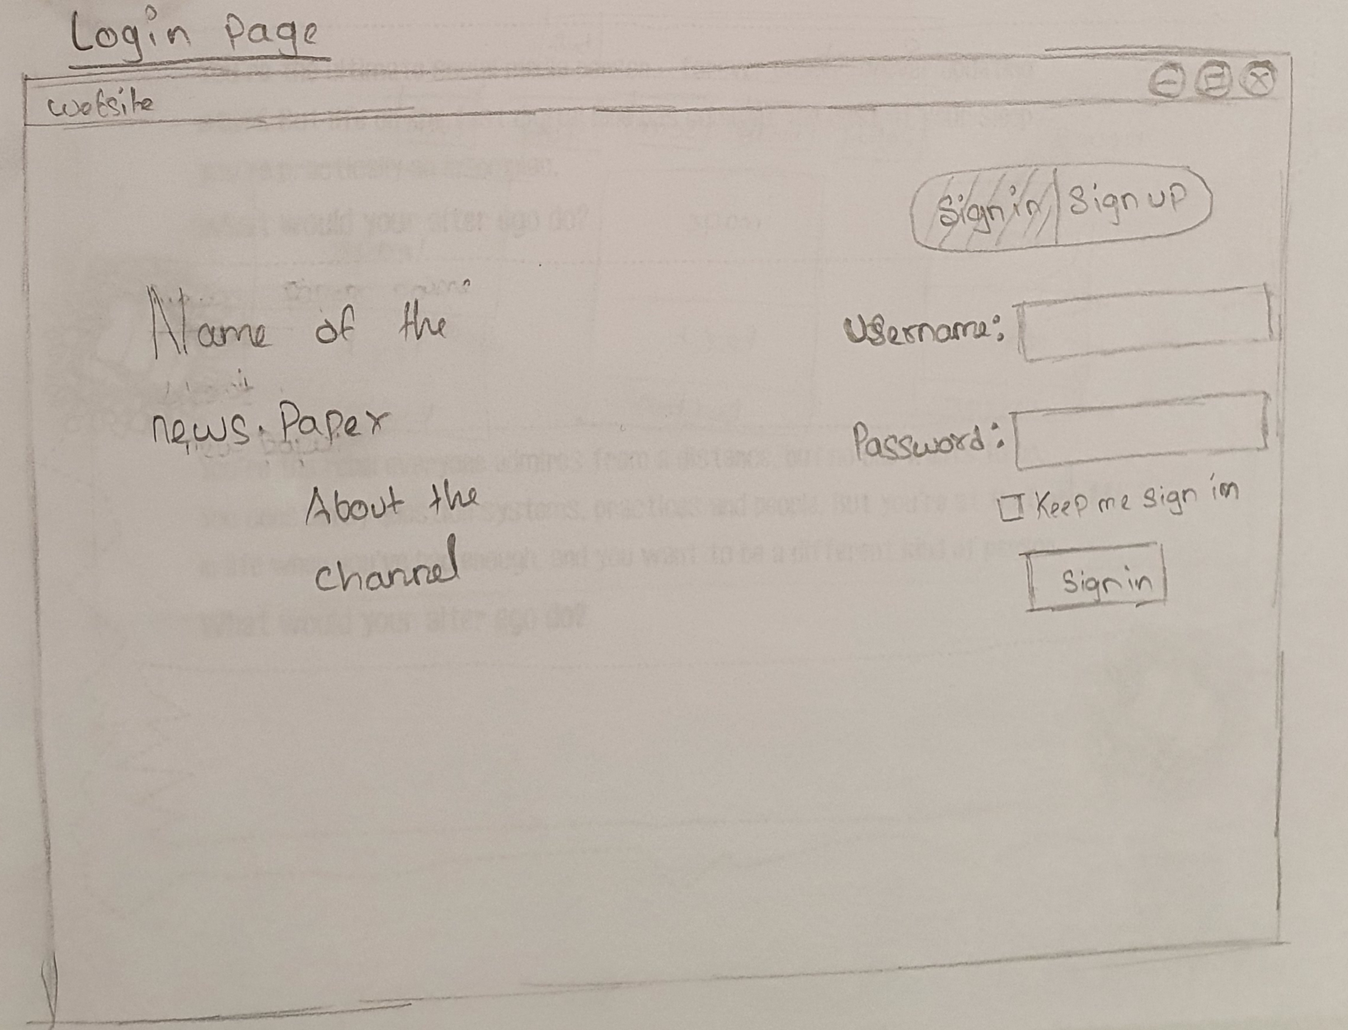
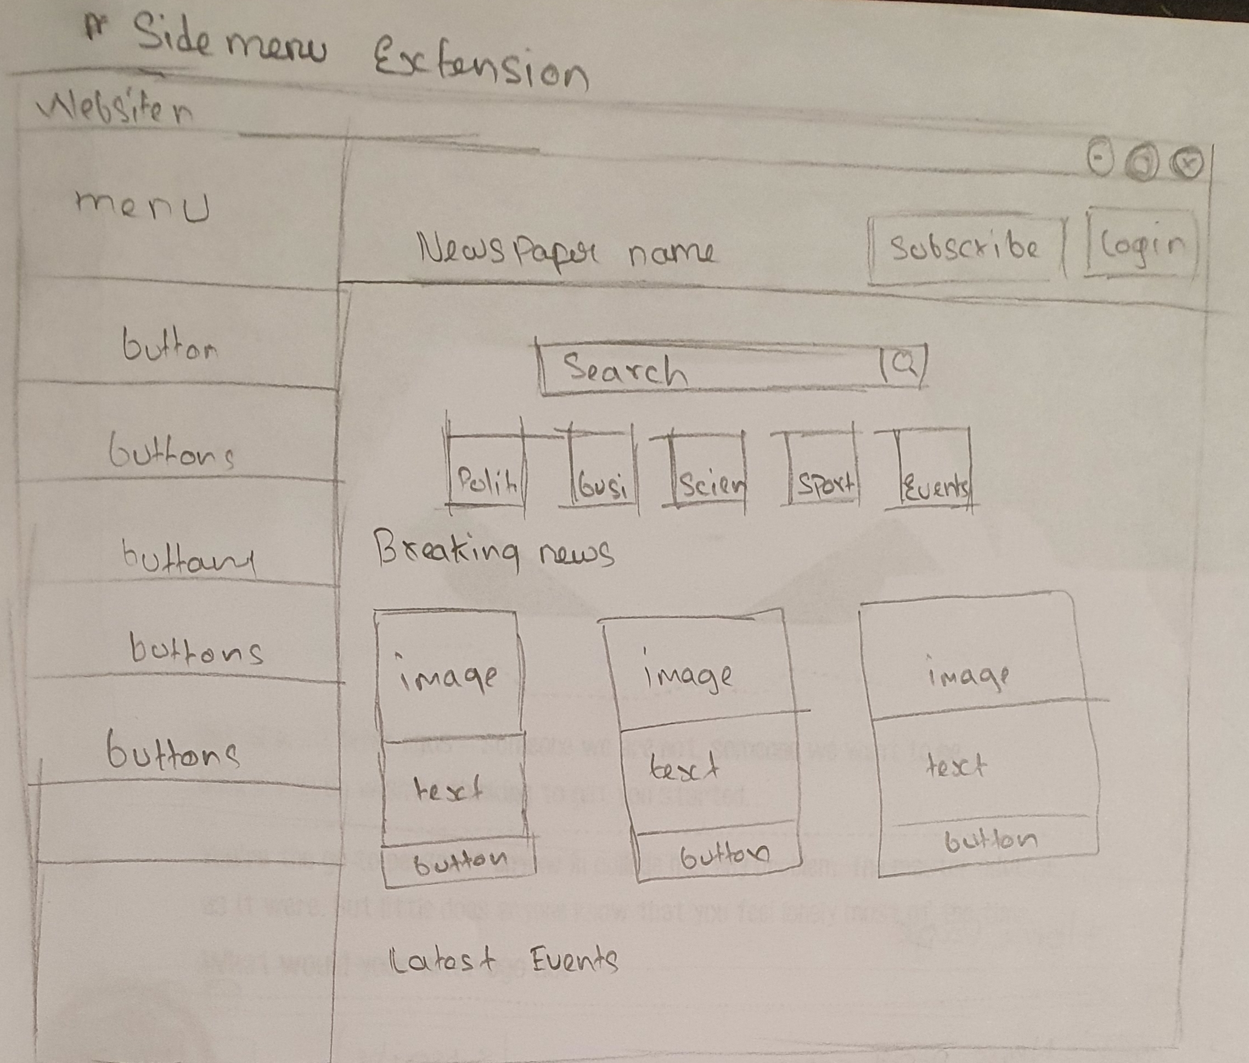
Design Process
Sketches
Home page
Category news page
profile page
Login page
sidemenu page

Slide 8
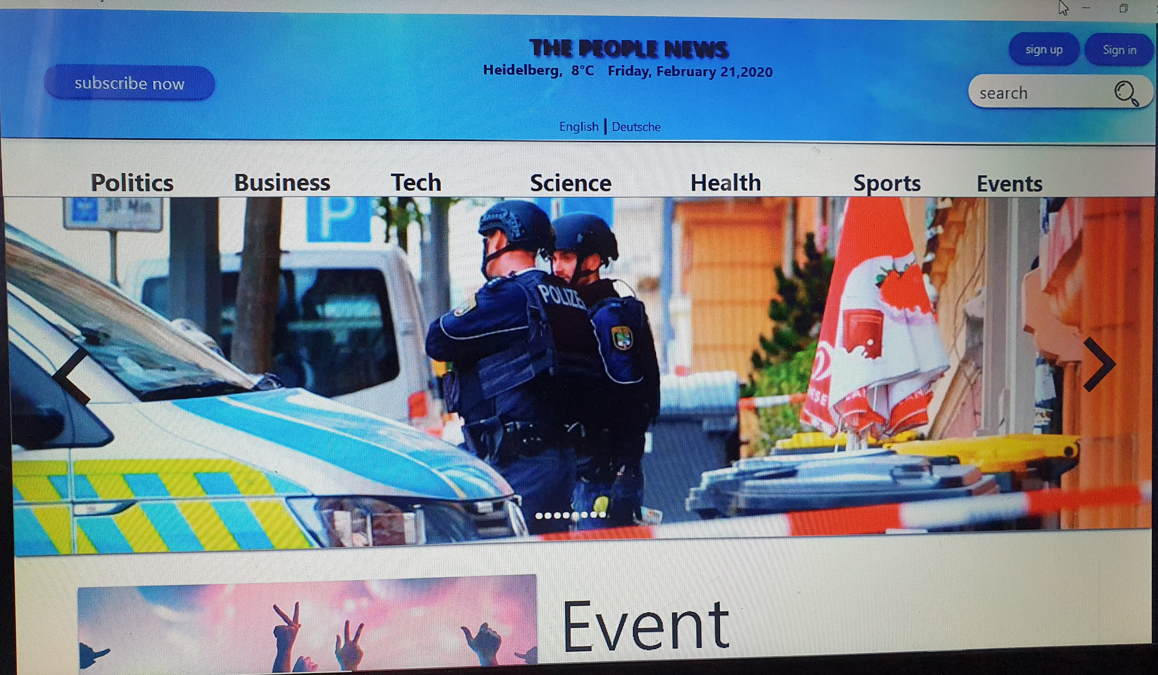
Design Process
previous mockup
Home page

Slide 9
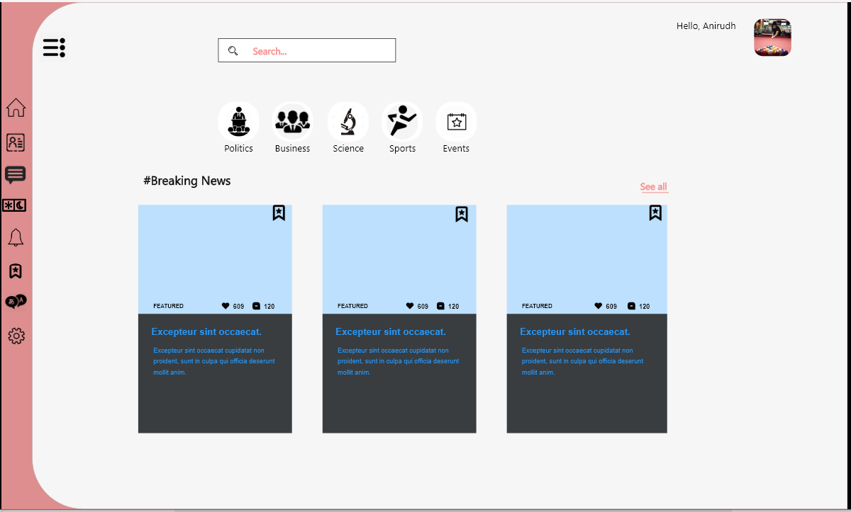
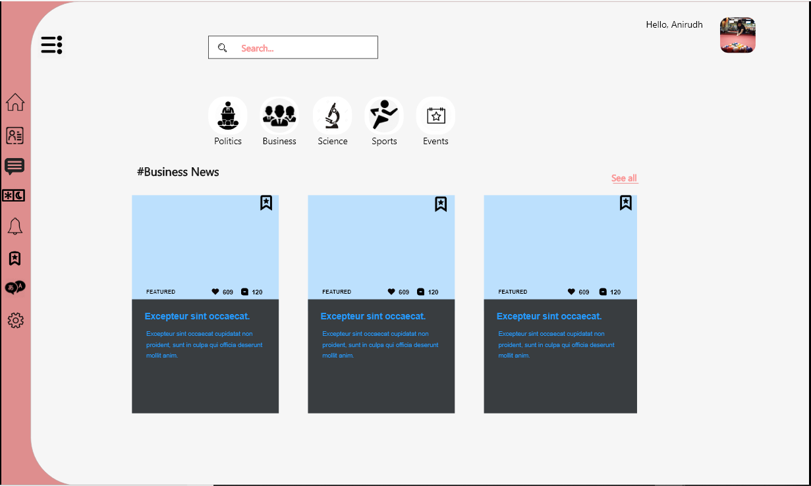
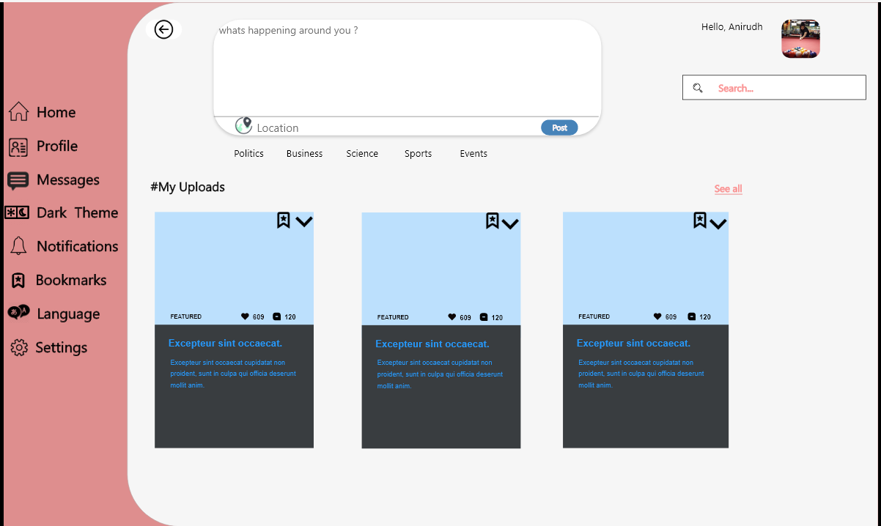
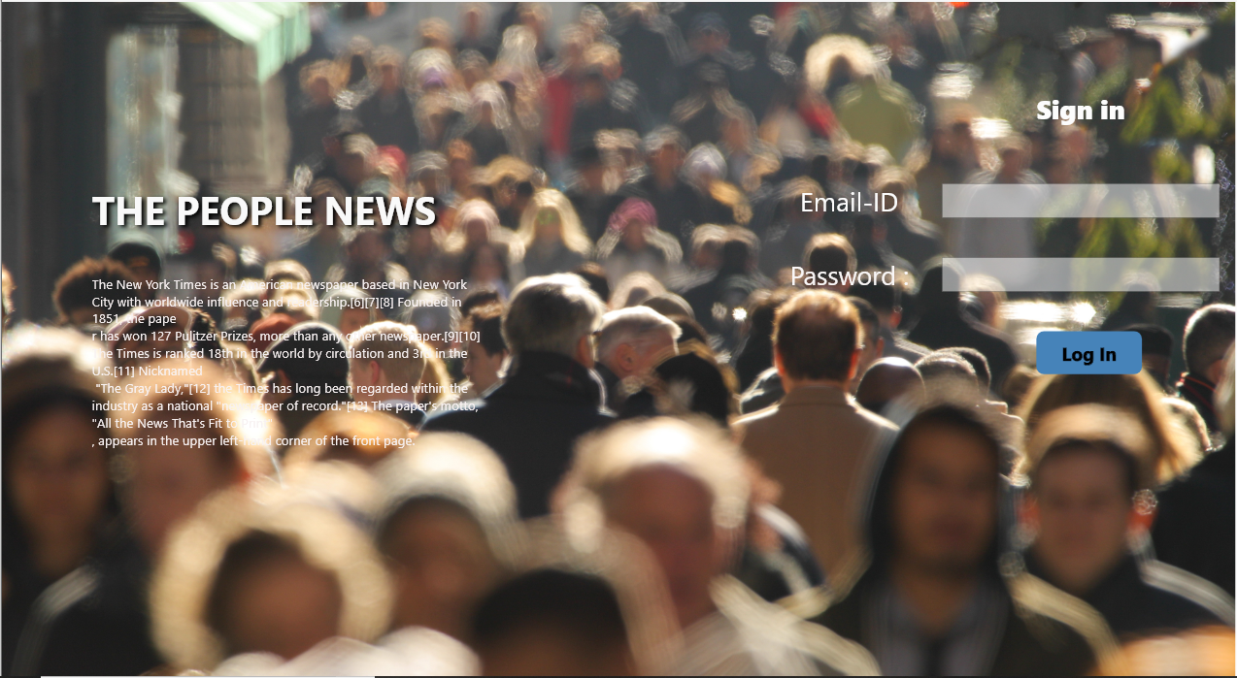
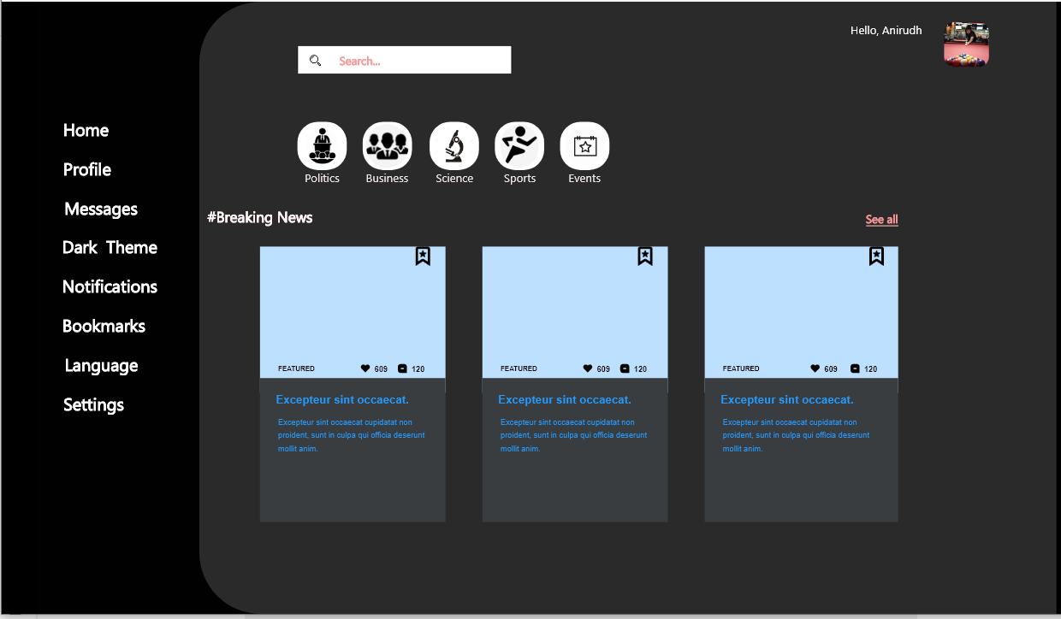
Design Process
Wireframes
Home page
Category news page
profile page
Login page
Dark theme page

Slide 10
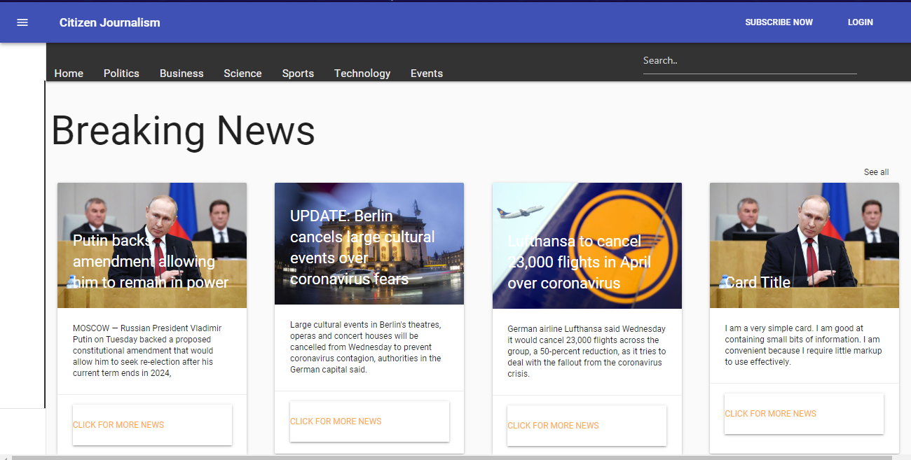
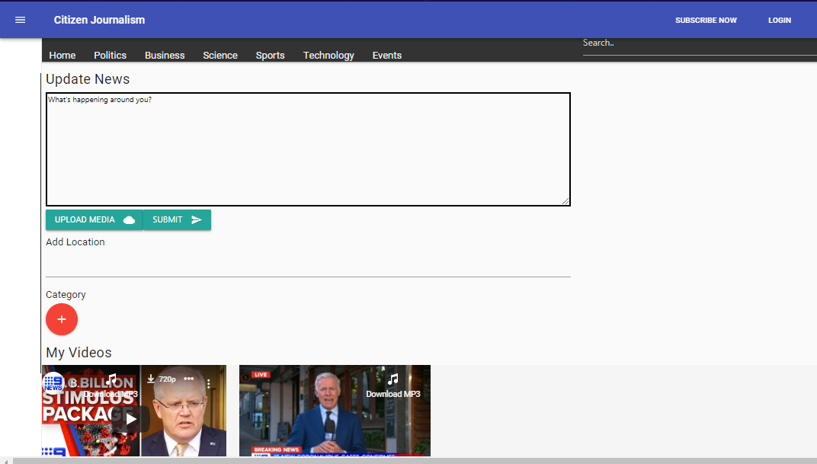
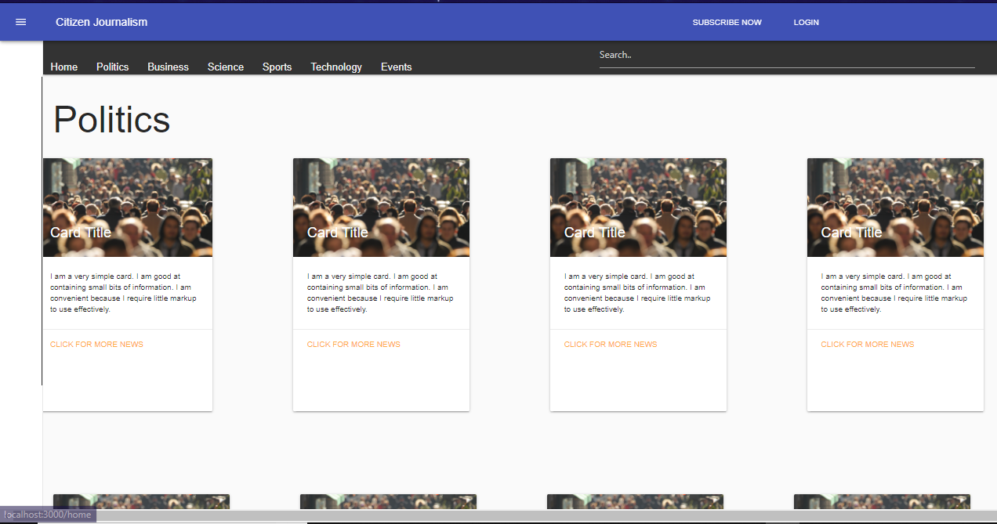
Design Process
Final Website

Slide 11
Usability testing
Think a loud
A think-aloud (or thinking aloud) protocol is a method used to gather data in usability testing in product design and development.
Think-aloud protocols involve participants thinking aloud as they are performing a set of specified tasks. Participants are asked to say whatever comes into their mind as they complete the task. This might include what they are looking at, thinking, doing, and feeling. This gives observers insight into the participant's cognitive processes (rather than only their final product)

Slide 12
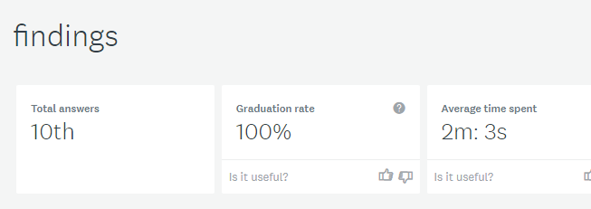
Usability testing
Step1: Create a survey on Survey Monkey to recruit participants for conducting a usability study. Share the survey on social media (Facebook, twitter, LinkedIn) and recruit people
Url: https://de.surveymonkey.com/results/SM-TGXDCVWT7/ • Conducted a survey using survey monkey to recruit users.

Slide 13
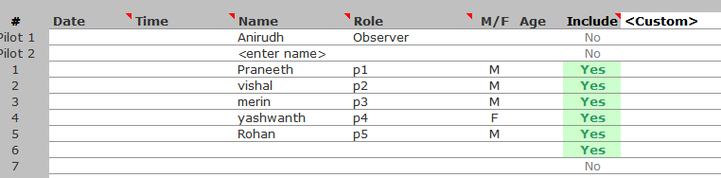
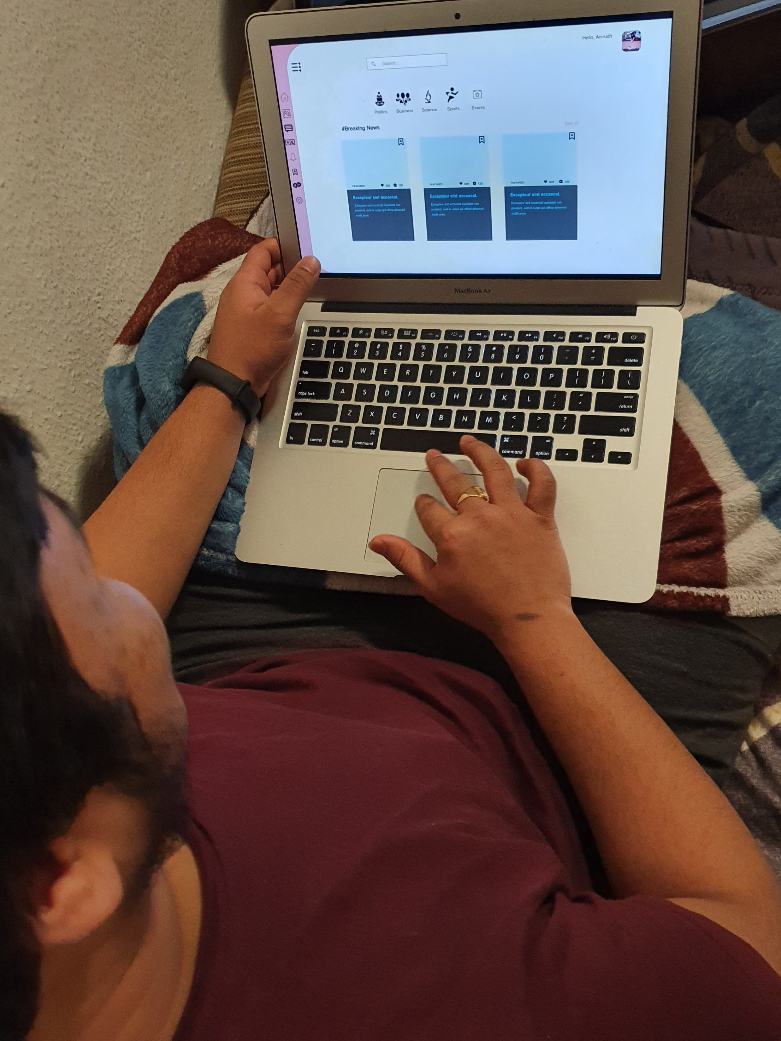
Usability testing
Step 2: Short list the users based on the survey who fits perfectly to your use case.
Step 3: confirm the meeting details with the user to conduct usability testing.
I have conducted testing in user’s environment. So that participants
feel more relaxed so that I can get more authentic response.

Slide 14
Test cases
Search for Breaking news
Search for dark mode
Subscribe news
Open business tab
Login and open profile
Upload news

Slide 15
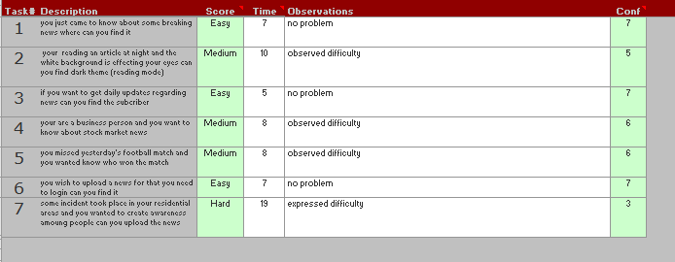
Usability testing
Step 4: give user a task to perform and observe his/her expression and the time
taken to complete his/her task.

Slide 16
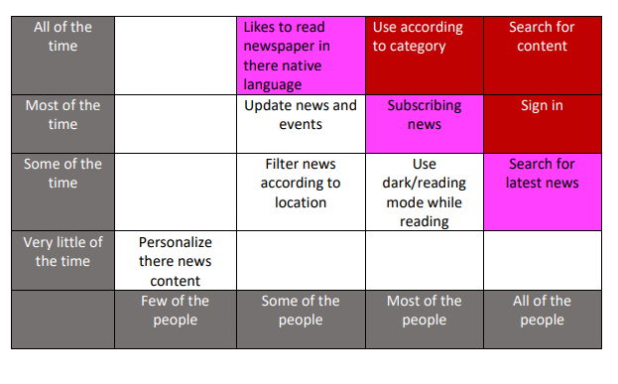
Red Routes
These are red Road for my use case of citizen journalist.

Slide 17
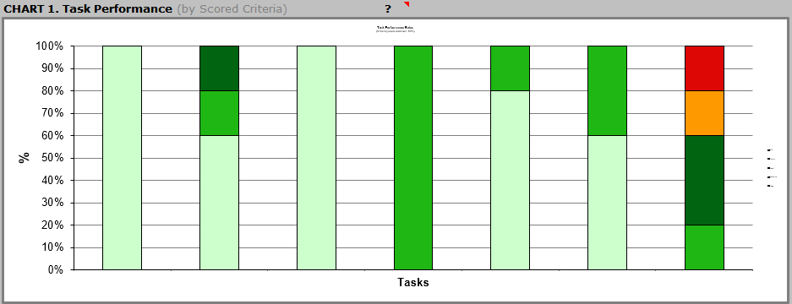
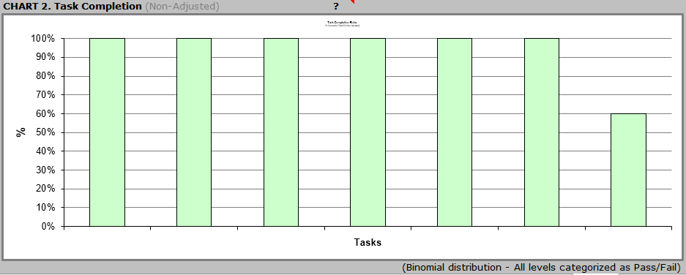
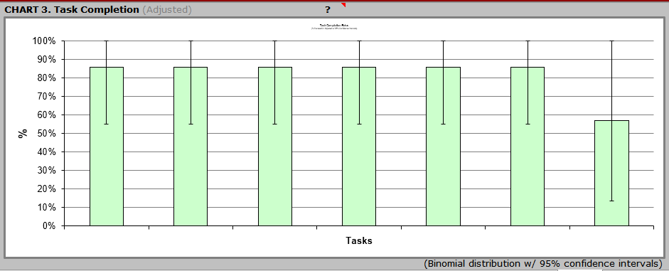
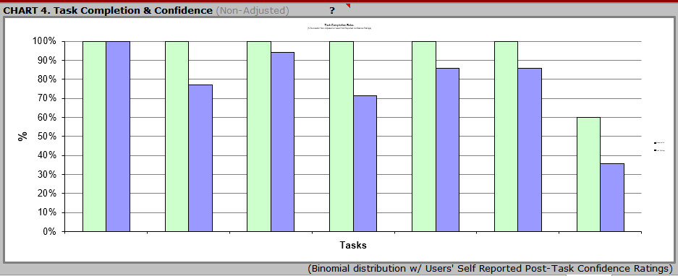
Analysis of the results

Slide 18
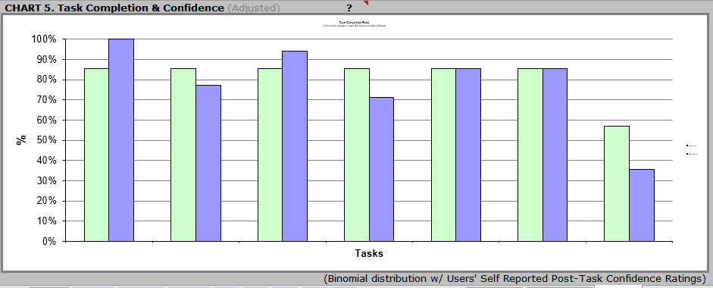
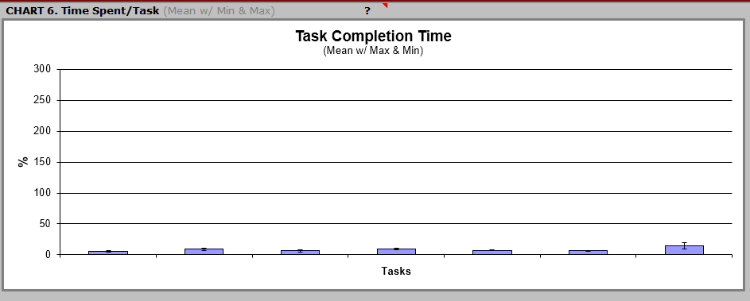
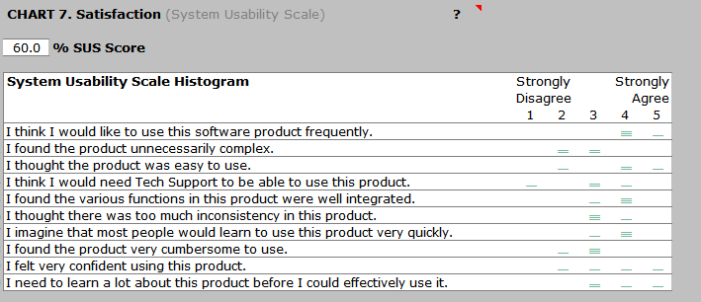
Analysis of the results

Slide 19
Lessons Learned
Single page Application using React framework
Designs
GitHub
What is think Aloud and Benchmark testing.
Automated testing

Slide 20
Thank you

